Slide 1
Chapter 3: Point-to-Point Connections- PPP
Connecting Networks
Notes:
Cisco Networking Academy program
Connecting Networks
Chapter 3: Point-to-Point Connections

Slide 2
Chapter 3
PPP Operation
Configuring PPP
Troubleshooting WAN Connectivity
Notes:
Chapter 5

Slide 3
PPP Operation
Notes:
3.2 PPP Operation

Slide 4
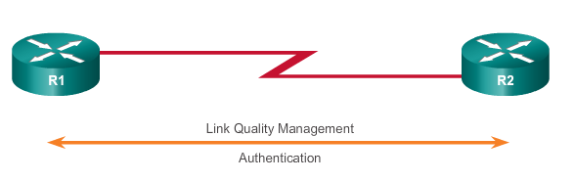
Benefits of PPP Why PPP?
PPP not proprietary
PPP includes many features not available in HDLC
Link quality management feature monitors the quality of the link. If too many errors are detected, PPP takes down the link
Supports PAP and CHAP authentication
Notes:
3.2.1.2 Advantages of PPP

Slide 5
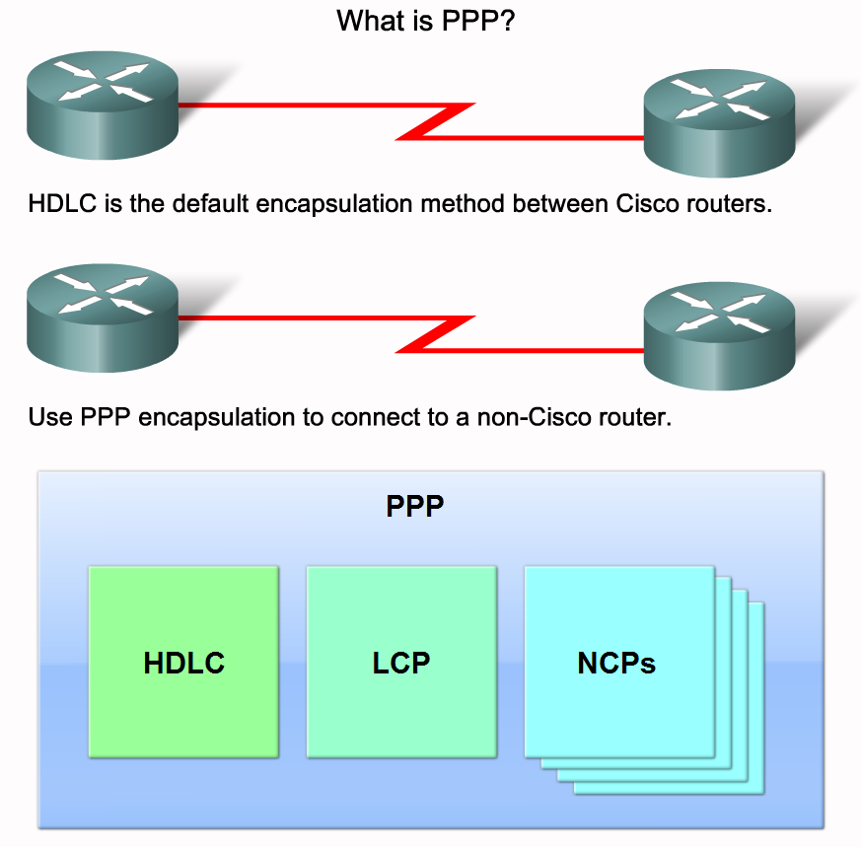
Introducing PPP

Slide 6
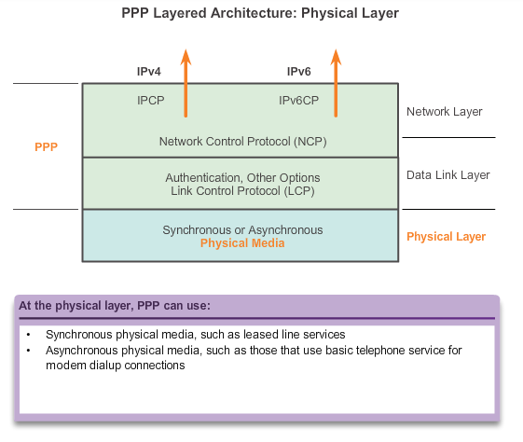
Physical Layer PPP Layered Architecture
PPP can be configured on multiple types of interfaces in the physical layer:
Asynchronous serial
Synchronous serial
High-Speed Serial Interface (HSSI)
Notes:
3.2.2.1 PPP Layered Architecture

Slide 7
LCP and NCP PPP Layered Architecture
LCP sets up the PPP connection and its parameters
NCPs handle higher layer protocol configurations
LCP terminates the PPP connection
Notes:
3.2.2.1 PPP Layered Architecture

Slide 8
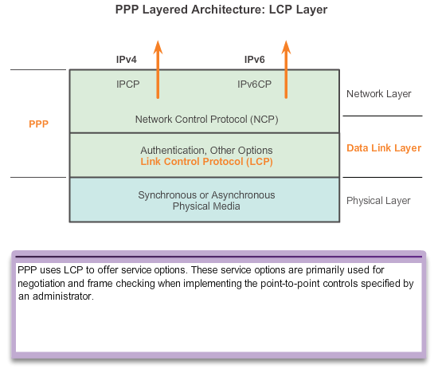
LCP and NCP PPP Control Protocol (LCP)
LCP provides automatic configuration of the interfaces at each end, including:
Handling varying limits on packet size.
Detecting common misconfiguration errors.
Terminating the link.
Determining when a link is functioning properly or when it is failing.
Notes:
3.2.2.2 PPP – Link Control Protocol (LCP)

Slide 9
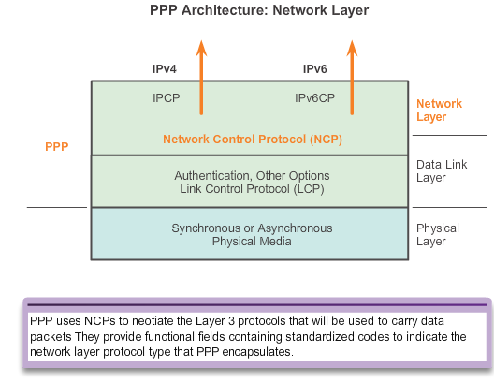
LCP and NCP PPP Network Control Protocol (NCP)
PPP permits multiple network layer protocols to operate on the same communications link.
For every network layer protocol used, PPP uses a separate NCP.
Notes:
3.2.2.3 PPP – Network Control Protocol (NCP)

Slide 10
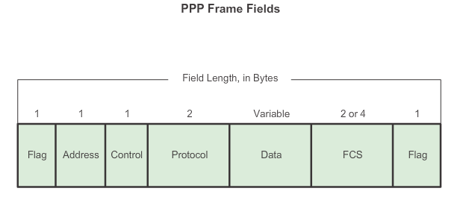
LCP and NCP PPP Frame Structure
Notes:
3.2.2.4 PPP Frame Structure

Slide 11
Establishing a PPP Session-3 Phases
Phase 1 – Link Establishment:
The LCP must first open the connection and negotiate configuration options.
Phase 2 – Determine Link Quality (Optional):
The LCP tests the link to determine whether the link quality is sufficient to bring up network layer protocols.
Phase 3 – Network Protocol Negotiation:
The appropriate NCP separately configures the network layer protocols.
The NCP can bring them up and take them down at any time.

Slide 12
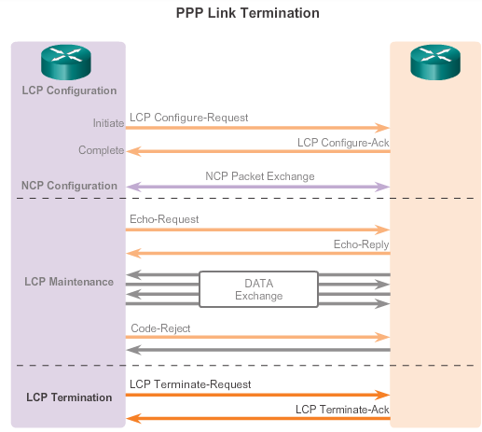
PPP Sessions LCP Operation (cont.)
Notes:
3.2.3.2 LCP Operation

Slide 13
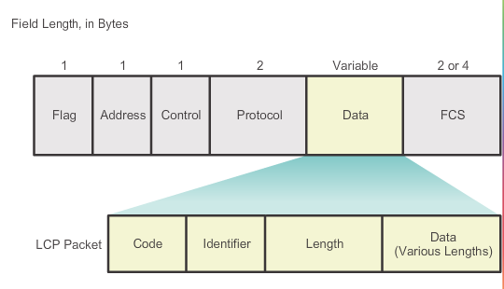
PPP Sessions LCP Packet
Notes:
3.2.3.3 LCP Packet

Slide 14
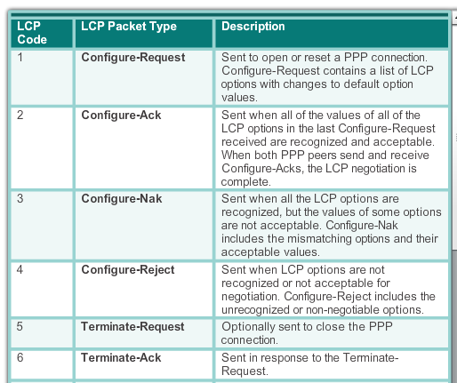
PPP Sessions LCP Packet
Notes:
3.2.3.3 LCP Packet

Slide 15

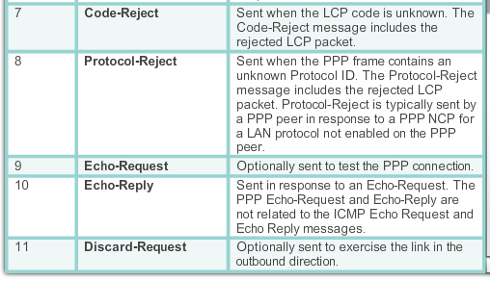
PPP Sessions LCP Packet (cont.)
Notes:
3.2.3.3 LCP Packet

Slide 16
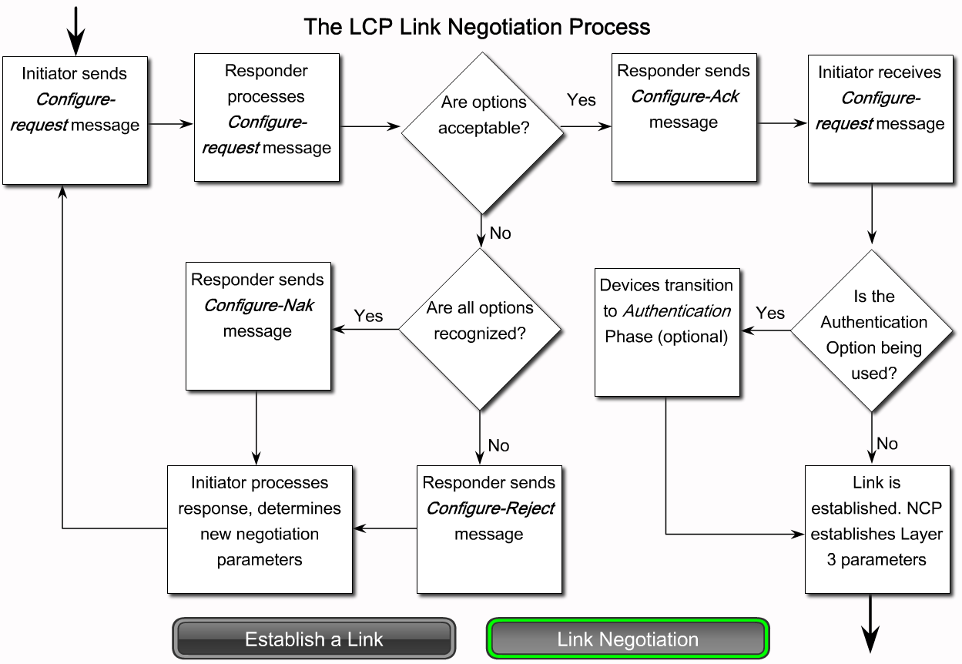
LCP Operation
Notes:
Graphic 2.2.5.1 (link negotiation)

Slide 17
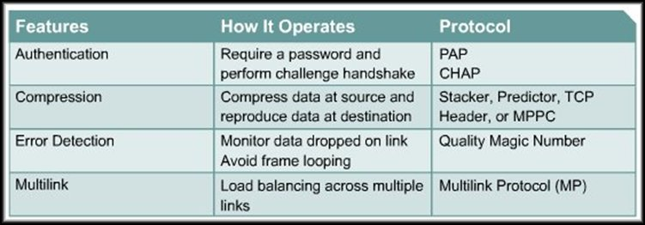
Establishing a Link with LCP
LCP frames contain a configuration option field that allows devices to negotiate the use of options such as:
As part of this phase, LCP also allows for an optional link-quality determination test.
The link is tested to determine whether the link quality is good enough to bring up network layer protocols.

Slide 18
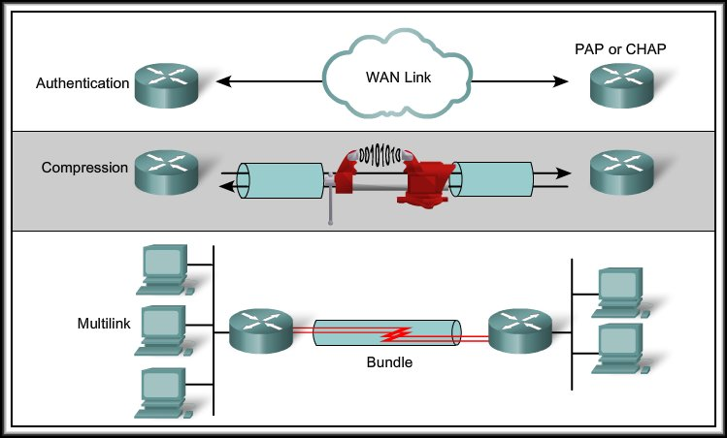
Establishing a Link with LCP
If a configuration option is not included in an LCP packet, the default value is assumed.
Before any network layer packets can be exchanged, LCP must first open the connection and negotiate the configuration parameters.

Slide 19
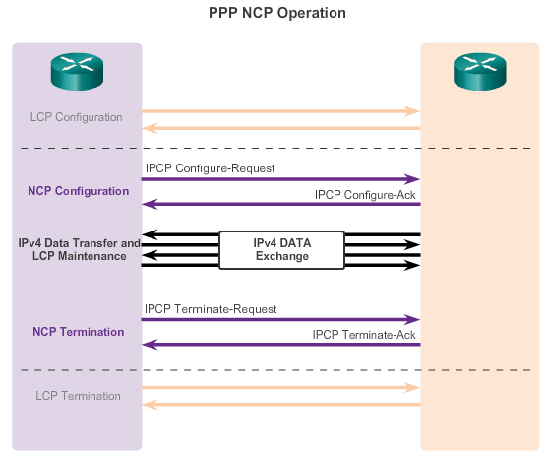
PPP Sessions NCP Explained
Notes:
3.2.3.5 NCP Explained

Slide 20
Configuring PPP
Notes:
3.3 Configuring PPP

Slide 21
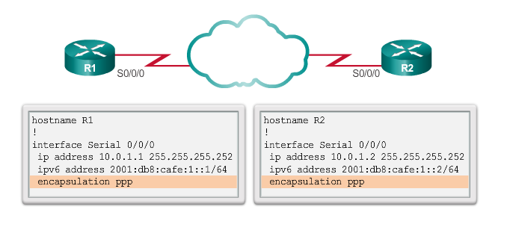
Configure PPP PPP Basic Configuration Command
Notes:
3.3.1.2 PPP Basic Configuration Command

Slide 22
Configure PPP PPP Configuration Options
Authentication – Two authentication choices are Password Authentication Protocol (PAP) and Challenge Handshake Authentication Protocol (CHAP).
Compression – Increases the effective throughput on PPP connections by reducing the amount of data in the frame that must travel across the link. The protocol decompresses the frame at its destination. Two compression protocols available in Cisco routers are Stacker and Predictor.
Error detection – Identifies fault conditions. The Quality and Magic Number options help ensure a reliable, loop-free data link. The Magic Number field helps in detecting links that are in a looped-back condition. Magic numbers are generated randomly at each end of the connection.
Notes:
3.3.1.1 PPP Configuration Options

Slide 23
Configure PPP PPP Configuration Options
PPP Callback – PPP callback is used to enhance security. With this LCP option, a Cisco router can act as a callback client or a callback server. The client makes the initial call, requests that the server call it back, and terminates its initial call. The callback router answers the initial call and makes the return call to the client based on its configuration statements. The command is ppp callback [accept | request].
Multilink – This alternative provides load balancing over the router interfaces that PPP uses. Multilink PPP provides a method for spreading traffic across multiple physical WAN links while providing packet fragmentation and reassembly, proper sequencing, multivendor interoperability, and load balancing on inbound and outbound traffic.
Notes:
3.3.1.1 PPP Configuration Options

Slide 24
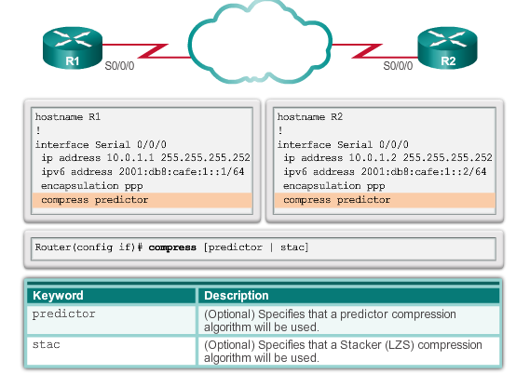
Configure PPP PPP Compression Commands
Notes:
3.3.1.3 PPP Compression Commands

Slide 25
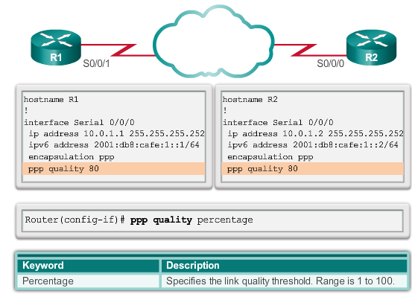
Configure PPP PPP Link Quality Monitoring Command
The ppp quality percentage command ensures that the link meets the quality requirement set; otherwise, the link closes down.
Notes:
3.3.1.4 PPP Link Quality Monitoring Command

Slide 26

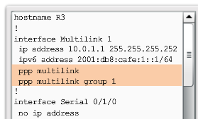
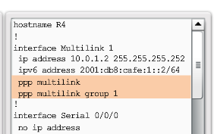
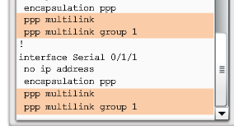
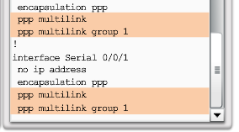
Configure PPP PPP Multilink Commands
Notes:
3.3.1.5 PPP Multilink Commands

Slide 27
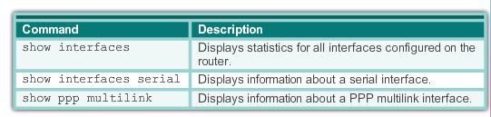
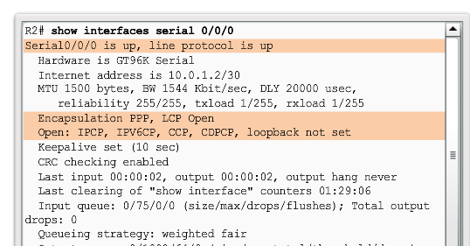
Configure PPP Verifying PPP Configuration
Notes:
3.3.1.6 Verifying PPP Configuration

Slide 28
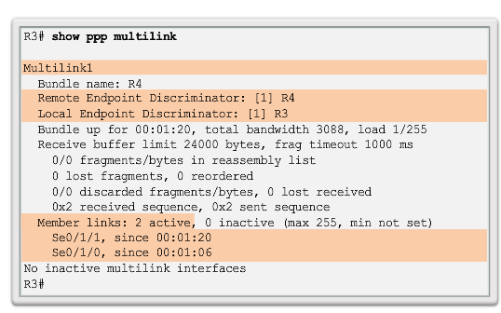
Configure PPP Verifying PPP Configuration (cont.)
The output indicates the interface Multilink 1, the hostnames of both the local and remote endpoints, and the serial interfaces assigned to the multilink bundle.
Notes:
3.3.1.6 Verifying PPP Configuration

Slide 29
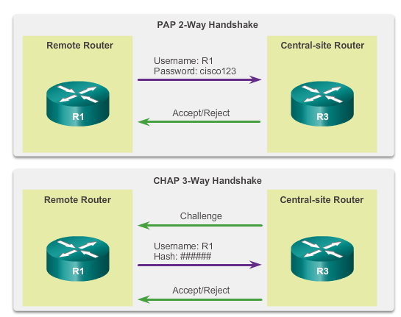
PPP Authentication PPP Authentication Protocols
Notes:
3.3.2.1 PPP Authentication Protocols

Slide 30
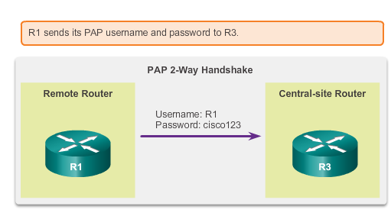
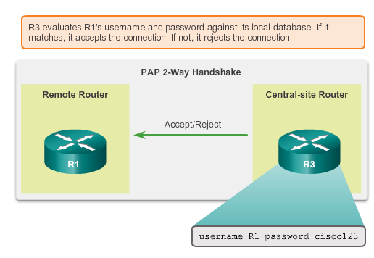
PPP Authentication Password Authentication Protocol (PAP)
Initiating PAP
Completing PAP
Notes:
3.3.2.2 Password Authentication Protocol (PAP)

Slide 31
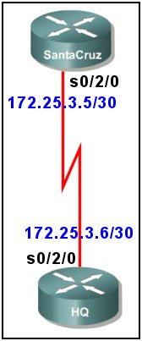
Remote usernames and passwords
PAP
hostname SantaCruz
username HQ password HQpass
interface serial 0/2/0
ip address 172.25.3.5 255.255.255.252
encapsulation ppp
ppp authentication pap
ppp pap sent-username SantaCruz password SantaCruzpass
hostname HQ
username SantaCruz password SantaCruzpass
interface serial 0/2/0
ip address 172.25.3.6 255.255.255.252
encapsulation ppp
ppp authentication pap
ppp pap sent-username HQ password HQpass
Local usernames and passwords

Slide 32
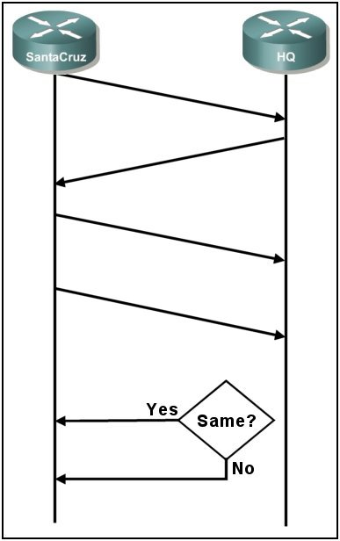
1. Establish PPP Link
2. Configuration request for PAP authentication.
1
3. Configuration ACK.
2
4. SantaCruz sends the SantaCruz username and SantCruzpass password configured for the interface.
3
5. HQ looks up the received name, retrieves the password and compares configured to received.
4
ACK
5
6. If they are the same, send an ACK and allow access. If they are not the same, send a NACK and terminate the connection.
6
NACK

Slide 33
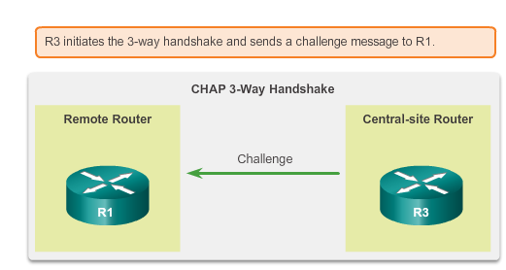
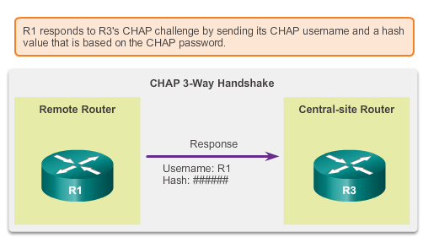
PPP Authentication Challenge Handshake Authentication Protocol
Initiating CHAP
Responding CHAP
Notes:
3.3.2.3 Challenge Handshake Authentication Protocol (CHAP)

Slide 34
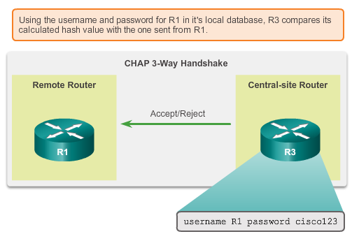
PPP Authentication CHAP (cont.)
Completing CHAP
Notes:
3.3.2.3 Challenge Handshake Authentication Protocol (CHAP)

Slide 35
PPP Configuration Command Summary
Router(config)#username name password password
Router(config)#interface serial 0/2/0
Router(config-if)#ip address address subnetmask
Router(config-if)#encapsulation ppp
Router(config-if)#ppp authentication chap
OR
Router(config-if)#ppp authentication pap
Router(config-if)#ppp pap sent-username name password password

Slide 36
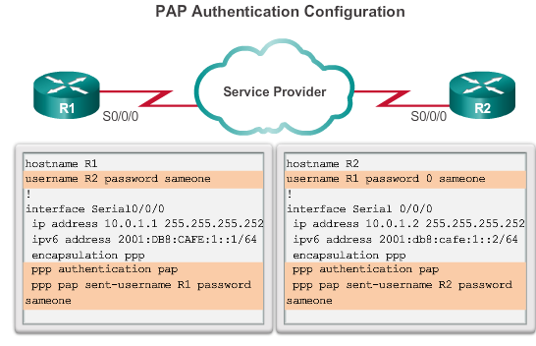
PPP Authentication Configuring PPP Authentication (cont.)
Notes:
3.3.2.6 Configuring PPP with Authentication

Slide 37
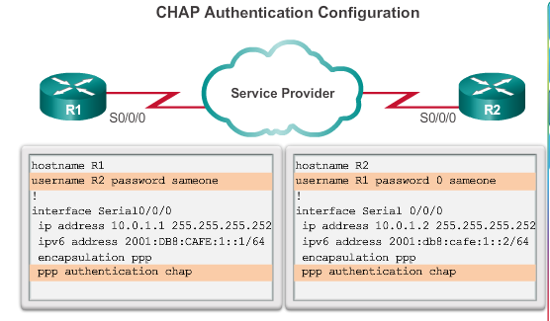
PPP Authentication Configuring PPP Authentication (cont.)
Notes:
3.3.2.6 Configuring PPP with Authentication

Slide 38
Troubleshooting WAN Connectivity
Notes:
3.4 Troubleshooting WAN Connectivity

Slide 39
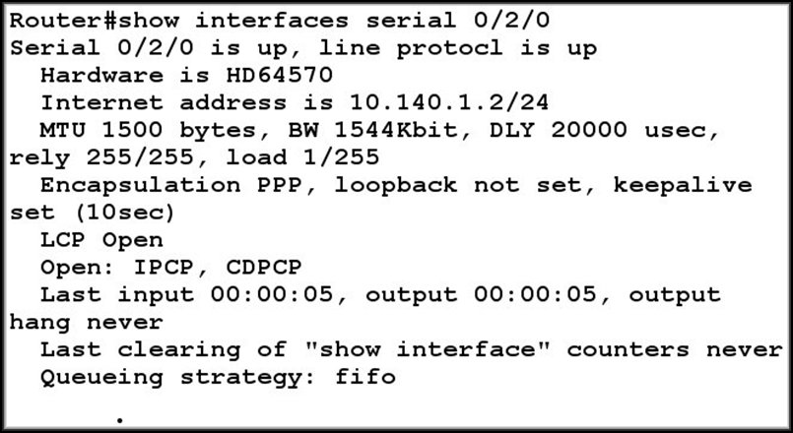
Network Layer Protocol Negotiation
LCP open = connection made.
NCPs
The show interfaces command reveals the LCP and NCP states under PPP configuration.

Slide 40
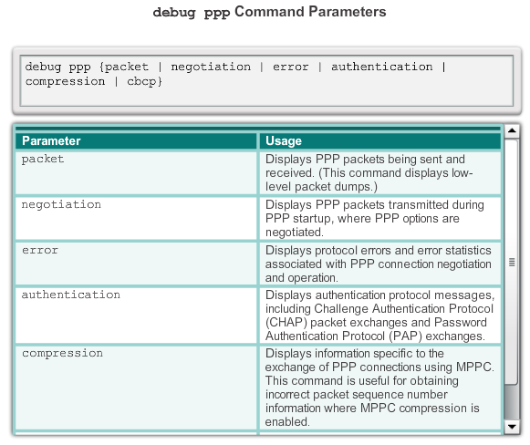

Troubleshoot PPP Troubleshooting PPP Serial Encapsulation
Notes:
3.4.1.1 Troubleshooting PPP Serial Encapsulation

Slide 41
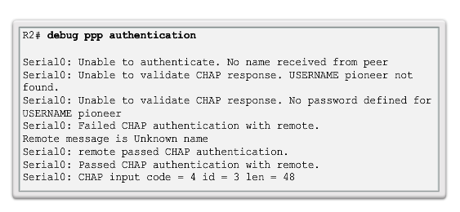
Troubleshoot PPP Troubleshooting a PPP Configuration with Authentication
Notes:
3.4.1.2/.3 Debug PPP/Troubleshooting a PPP Configuration with Authentication

